Slide 1
Serverless Architecture

Slide 2

Hello!
I am Hassan Murtaza
DevOps/Cloud Engineer @ OneByte
You can find me at
Writes @ hassanmurtaza.com
OpenSource @ github.com/MrHassanMurtaza

Slide 3
What’s the Agenda
Journey to Serverless
What is Serverless
Why Serverless
Serverless in Production
Serverless Frameworks
Demo

Slide 4
How we got here?
On Premise

Slide 5
How we got here?
On Premise
Cloud & Virtualization

Slide 6
How we got here?
Infrastructure as a service (IAAS)
On Premise
Cloud & Virtualization

Slide 7
How we got here?
Infrastructure as a service (IAAS)
On Premise
Cloud & Virtualization
Platform as a service (PAAS)

Slide 8
How we got here?
Infrastructure as a service (IAAS)
Serverless (FAAS)
On Premise
Cloud & Virtualization
Platform as a service (PAAS)

Slide 9
What is Serverless
Why are we here today? What the heck is serverless?

Slide 10
In a nutshell, serverless is a cloud computing architecture that allows developers to build and run code without having to manage, provision, or monitor infrastructure.

Slide 11
Why Serverless
No Infrastructure Provisioning, No management of servers.
Autoscaling / Load Balancing
Pay for Value
Highly Available and Secure

Slide 12
Supports Multiple Runtimes
NodeJS
Python
GO
Ruby
C#
Java

Slide 13
Serverless in Production
Possibilities are limitless but let’s discuss some common use cases.

Slide 14
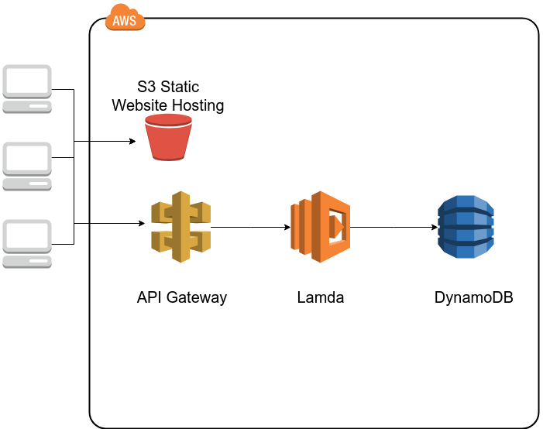
Simple Website with Backend Logic

Slide 15
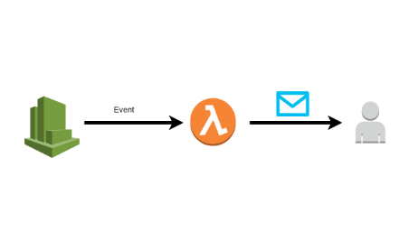
Automating Regular Jobs

Slide 16
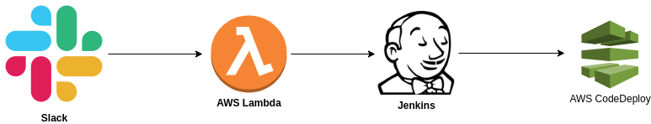
How we are using at OneByte

Slide 17
Serverless Frameworks
Zappa for Python
Serverless Framework Nodejs
Chalice
Serverless Application Model (SAM) by AWS

Slide 18
Enough Talk! Let’s Demo;

Slide 19
Demo on AWS Console

Slide 20
Demo using Serverless Framework

Slide 21
Demo on Local using FN Project

Slide 22
Thanks!
Any questions?
You can find me at hassanmurtaza.com & mrhassanmurtaza@gmail.com

